Slide 1

Primary & Urgent Care Clinic Operation
Presenters: Trang Nguyen, Tam Nguyen, Uyen Tran, Qi Wang

Slide 2



TABLE OF CONTENTS
01
04
PROBLEM
RESULTS
02
05
METHODOLOGY
RECOMMENDATION & STRATEGIES
03
06
MODEL
QUESTIONS

Slide 3


01 - BUSINESS PROBLEM
Long waiting line for customers
Low utilization
→ Negative effects on clinic’s reputation
→ Loss of customers

Slide 4


OBJECTIVES
Create a well-managed supportive management structure to maximize resource utilization and improve productivity in the workforce, while minimize waiting time for patients.

Slide 5

02
METHODOLOGY

Slide 6

ASSUMPTIONS
01
02
03
Service Time Distribution
Service times for different components (receptionists, medical assistants, doctors) follow triangular probability distributions.
Homogeneous Patient Behavior
All patients behave similarly and follow the same path through the clinic (e.g. registration, examination).
Fixed Service Capacities
The number of receptionists, medical assistants, and doctors remains constant during the simulation.

Slide 7
DATA COLLECTION & OBSERVATION
Conducting interviews with the office manager at the clinic.
Recording timestamps of key events such as patient arrivals, waiting time and service completion.

Slide 8

DATA COLLECTION & OBSERVATION
Service Time
Arrival Rates
Number of patients arrive per hour
Time patients spend receiving service at receptionist, medical assistant and doctor
Financial Information
Staffing
Employees Hourly Pay Rate
Supplies Cost & Staff Wage
Appointment Revenue
Number of employees in each position

Slide 9



Data
Arrival Rates
Staffing
Service Time
(minute)
02
(3, 9, 15)
NP
1/hour
Receptionist
Trainee (20, 25, 30)
Junior (18, 21.5, 25)
Senior 1 (13, 18.5, 24)
Senior 2 (10, 15, 20)
EP
4/hour
04
Medical Assistant
WP
0.5/hour
01
(15, 17.5, 25)
Doctor

Slide 10
Data
Financial Information
Employees Hourly Pay Rate
Trainee | $12
New Medical Assistant | $14
Senior 1 | $15
Senior 2 | $17
Receptionist 1 | $13
Receptionist 2 | $13
Doctor | $48

Slide 11
Data
Financial Information
Medical Supplies | $20/patient
Staff Wages | $1,333.20
Average Office Visit Fees | $215/patient

Slide 12
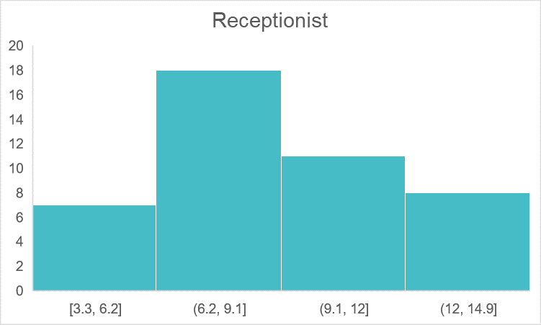
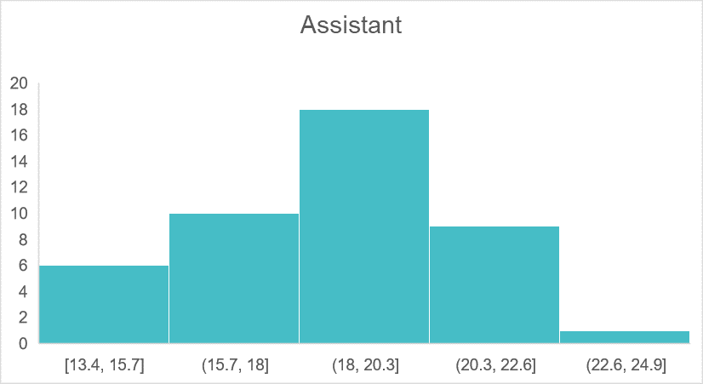
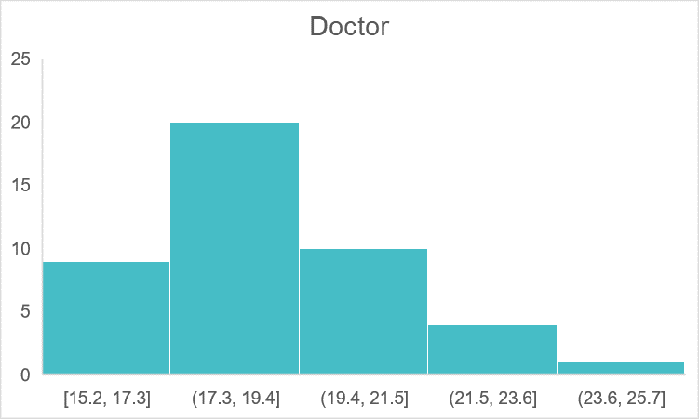
Statistical Analyses
Distribution of Service Time for Receptionist, Medical Assistant, and Doctor

Slide 13

03
MODEL
JaamSim model

Slide 14
PROCESS FLOW
P ~ Triangular(10, 15, 20)
Senior 2
Senior 2
40 %
P ~ Triangular(13, 18.5, 24)
New Patients
P ~ Triangular(3,9,15)
1 /h
50 %
Receptionist 1
30 %
Senior 1
P ~ Triangular(15, 17.5, 25)
Established Patients
4 /h
Waiting Area
Doctor
0.5 /h
Senior 2
Check out
50 %
Receptionist 2
20%
New Medical Assistant
Walk-in Patients
P =5 min
P ~ Triangular(3,9,15)
P ~ Triangular(18, 21.5, 25)
10 %
Trainee
P ~ Triangular(20, 25, 30)

Slide 15
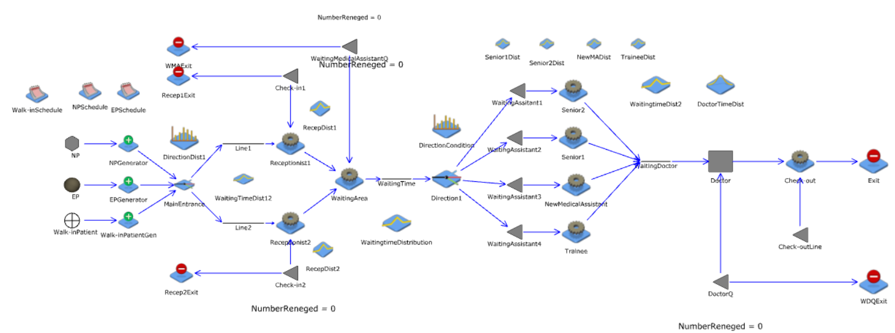
MODEL
Repetitions - 100 times
Duration - 11.1 hours

Slide 16

04
RESULTS

Slide 17
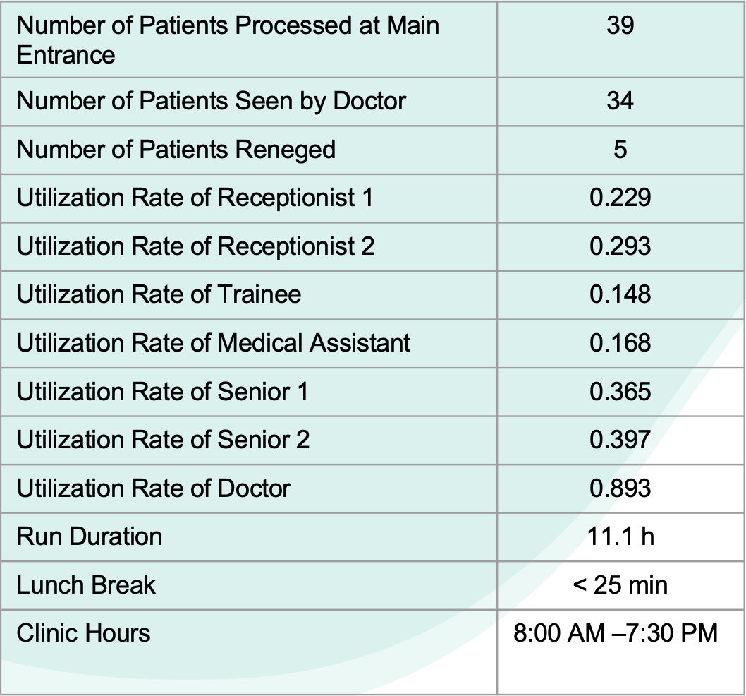
Results of Clinic Operations: Patient Flow and Utilization

Slide 18
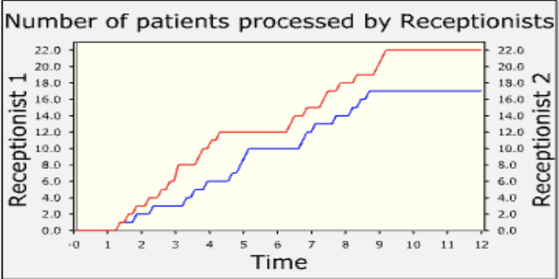
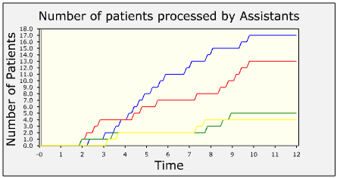
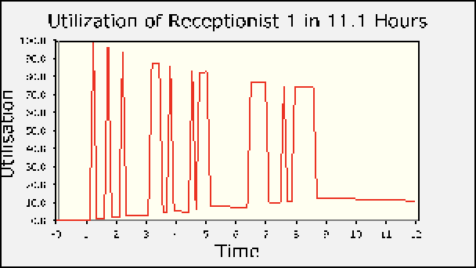
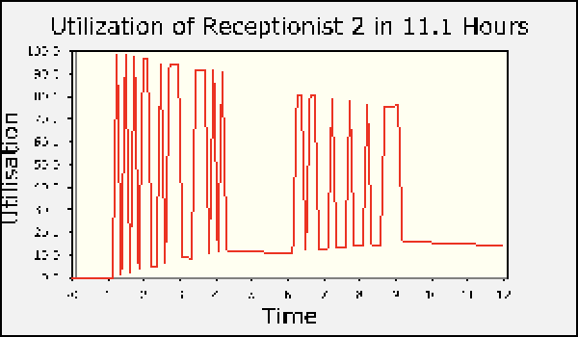
Recep1
Recep2
Senior 1 Senior 2 NMA Trainee

Slide 19
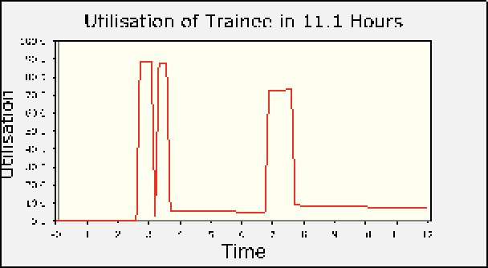
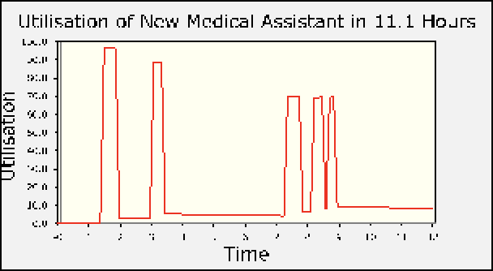
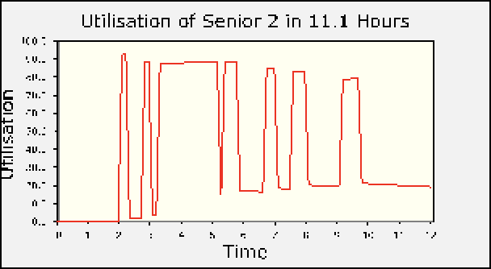
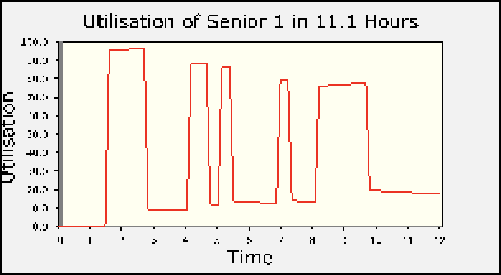

Slide 20
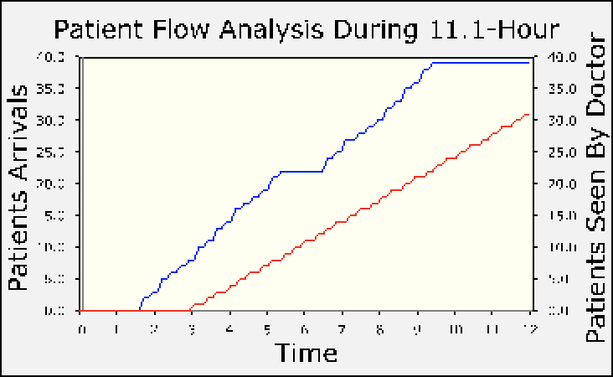
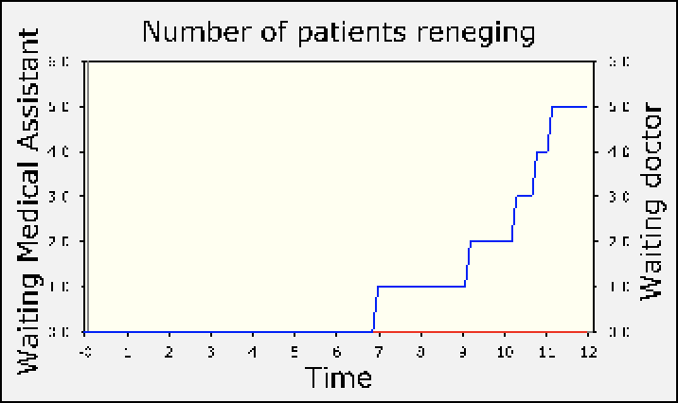
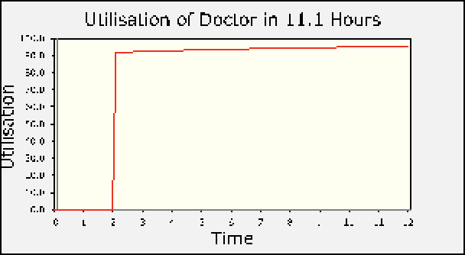

Slide 21
Clinic Operation Revenue
MEDICAL SUPPLIES
STAFF WAGES
$1,333.20
$680
TOTAL REVENUE
DAILY PROFIT
$7,310.00
$5,296.80

Slide 22

05
CONCLUSION & RECOMMENDATION

Slide 23
CONCLUSIONS
Long Patient Queue Times
Doctor Workload
Uneven Staff Utilization

Slide 24
RECOMMENDATION
Enhance Medical Team Capacity: Add a registered nurse to reduce waiting time and ensure high-quality care.
Accommodate More Patients: Reorganize the scheduling calendar with specific time slots.
Optimize Staffing Levels: Implement a rotating schedule to balance staffing, avoiding shortages and excesses.
Inform Patients: Pre-inform patients about potential waiting time to manage expectations.

Slide 25

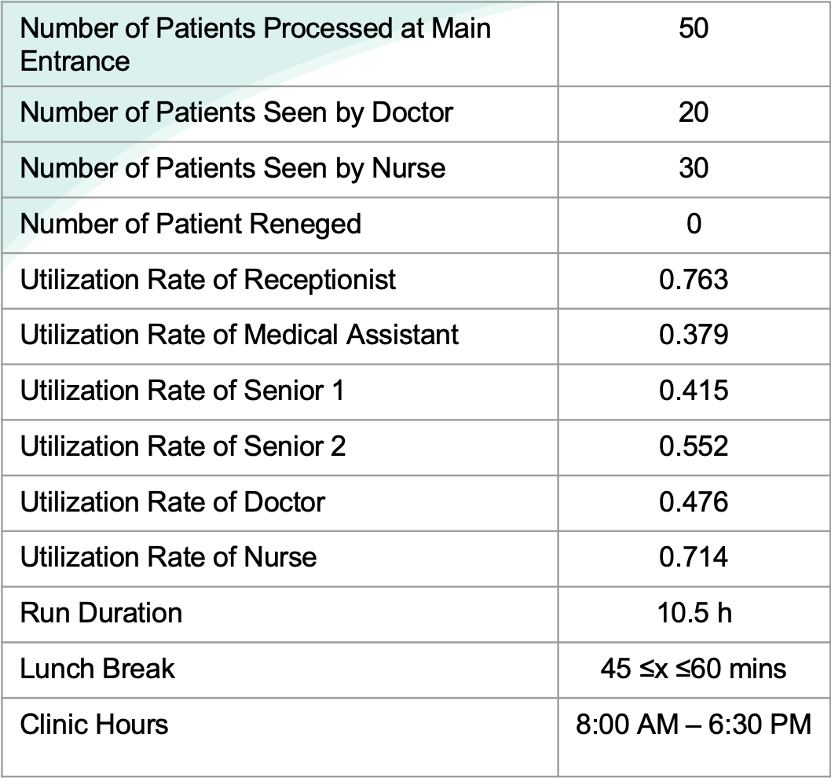
Improvement Summary of New Clinic Strategy Models to the Current Model

Slide 26
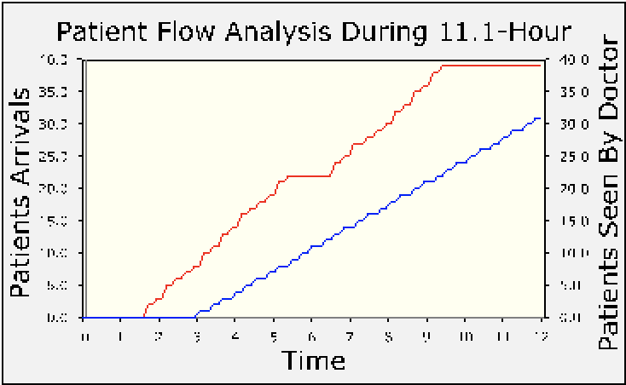
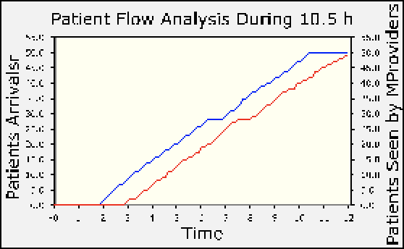
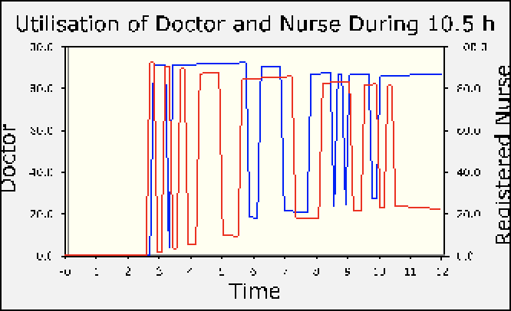
Patients Arrivals
Patients Seen
Doctor
Nurse

Slide 27
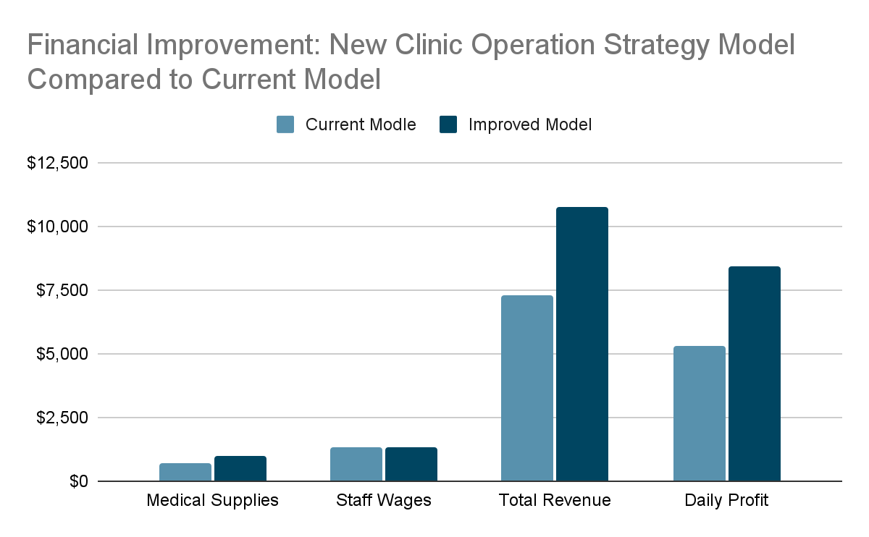
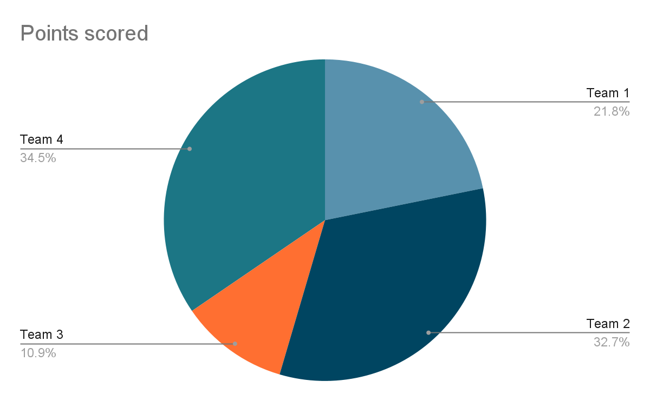

Slide 28
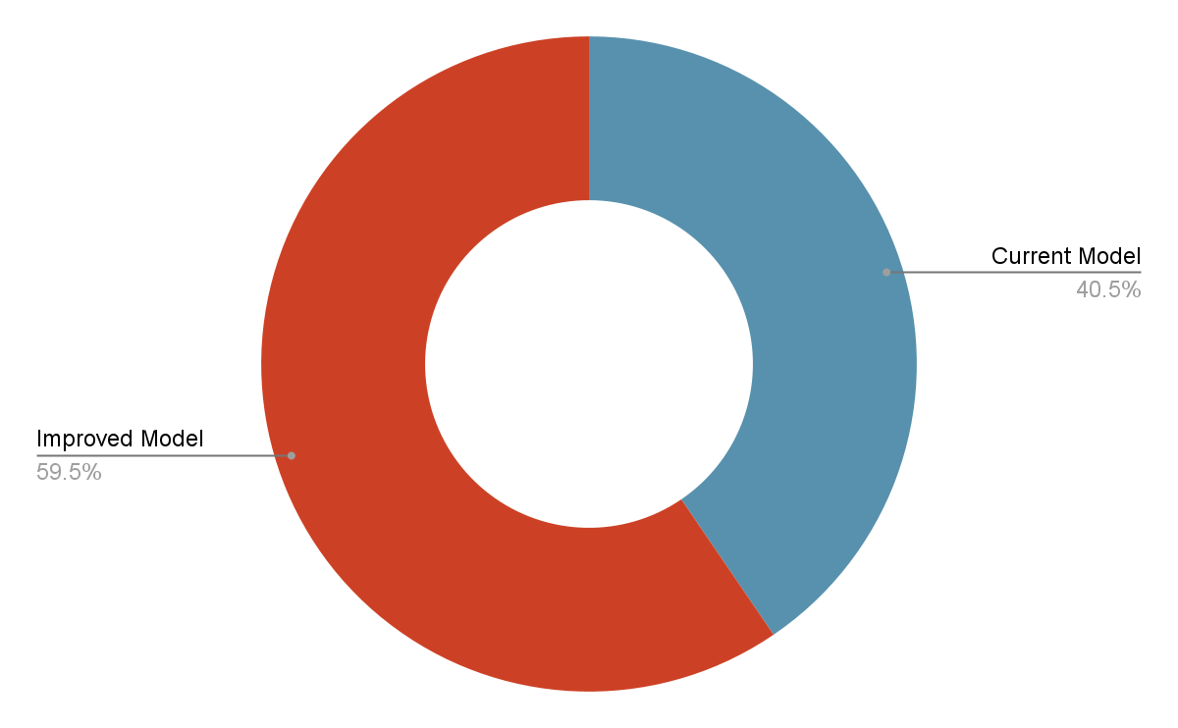

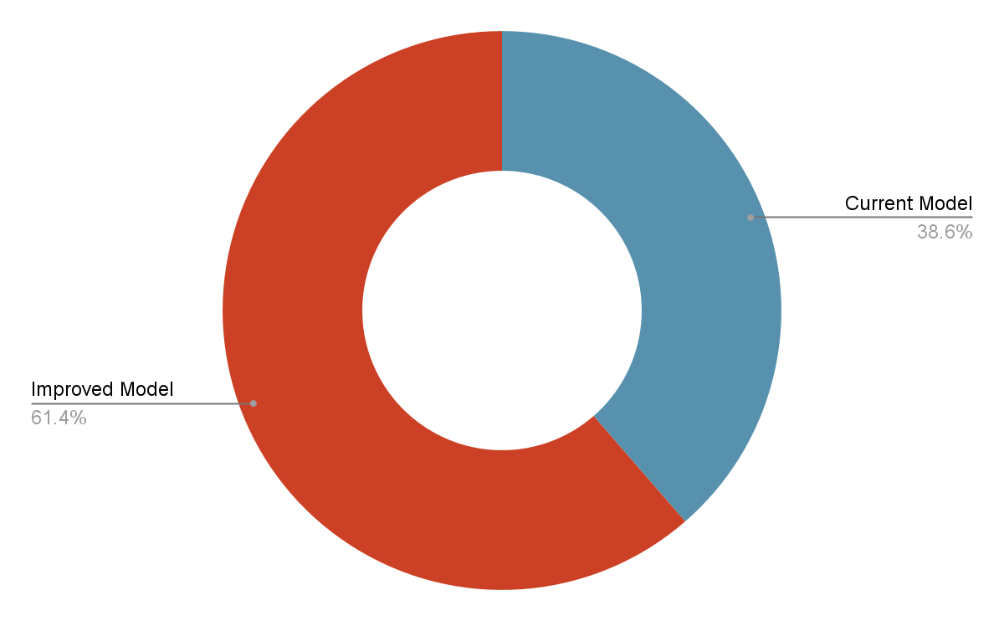
Improvement Metrics
19%
100%
22.8%
Improved Clinic Flows with More Patients
Reduce Reneging
Increased Clinic’s Daily Profit

Slide 29

THANK YOU

